Slide 1
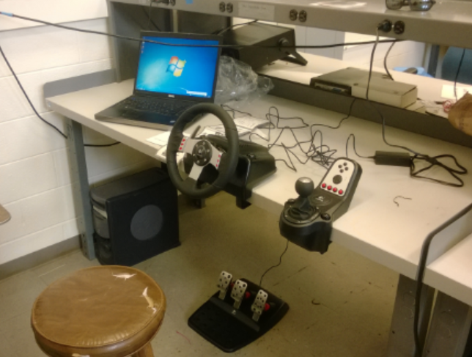
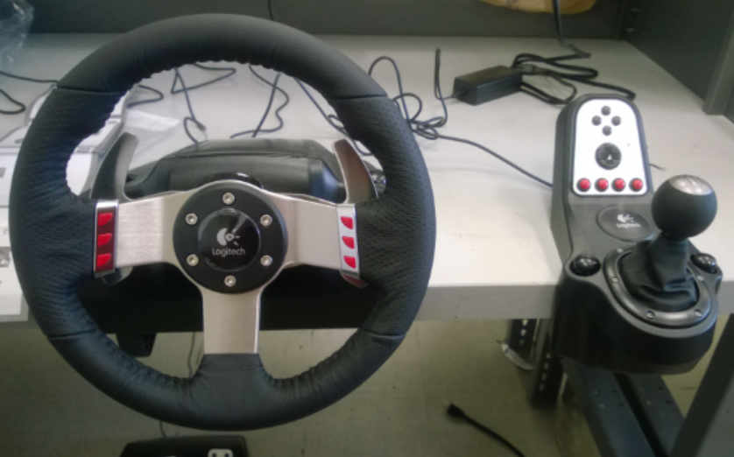
Simulation Setup
Simulation running on Laptop
User input on Logitech G27 Racing Wheel

Slide 3
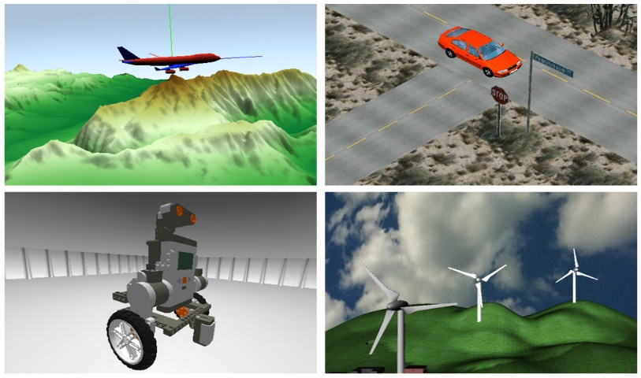
Simulation Environment
Chose to use Simulink 3D for first simulation.
May develop in other software in the future (Unity, rFactor, etc.)
http://www.mathworks.com/cmsimages/58961_wl_sm_3danim_fig1_wl.jpg

Slide 4
Simulation Environment
Pros:
Environment natively communicates with car model.
Will be easy to maintain and update (improve MATLAB model but simulation environment stays the same).
Cons:
Not as visually immersive.
Almost all development (Environment, Physics, etc.) is in house.
Does not natively understand controller inputs or haptic feedback

Slide 5
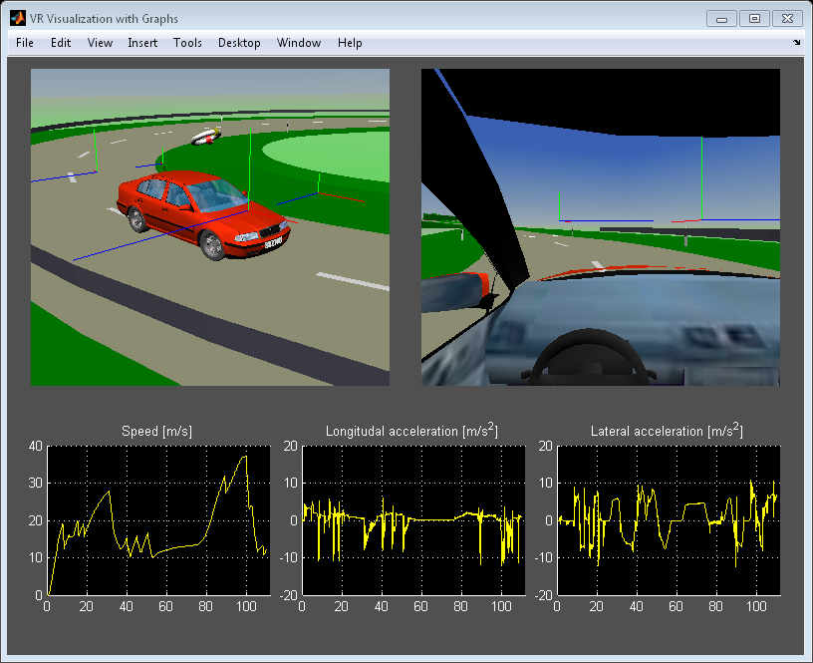
Simulation Environment
http://www.mathworks.nl/help/releases/R2013b/sl3d/examples/vr_octavia_graphs_02.png

